Slide 1
DEF/LEF to SVG
Ahmed Sharaf-ElDein
Ahmed Marzouk
Alaa Mohamed
Ahmed Fayed

Slide 2
Problem
- Convert a routed design in DEF and LEF to a layout in SVG.
- Make it web-based.

Slide 3
File Formats
Input files:
DEF file
LEF file
Output file:
SVG file

Slide 4
Solution
- Parse the DEF and LEF files.
- Iterate through the parsed DEF object and, using SVG library and the parsed LEF, draw:
Every cell given the dimensions stated in the LEF file and the locations stated on the .def file.
The pins.
The nets.

Slide 5
Code structure
index.js
SVGlib.js
parser.js
drc.js
svgZoomPan.js

Slide 6
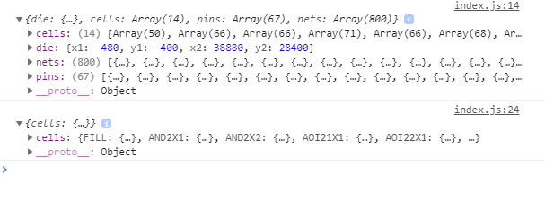
Parsing the DEF and LEF files.

Slide 7
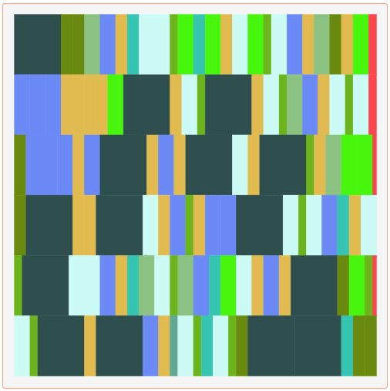
Drawing the cells

Slide 8
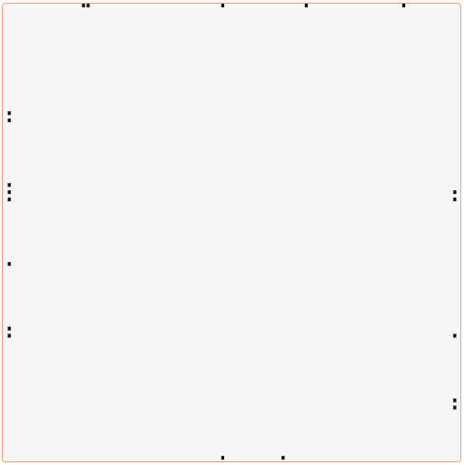
Drawing the pins

Slide 9
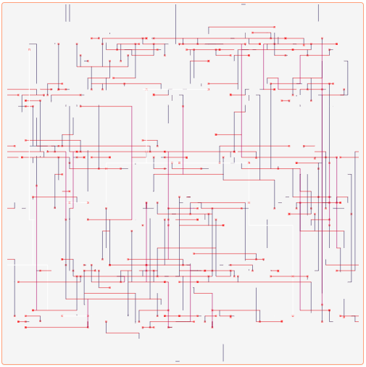
Drawing the Nets

Slide 10
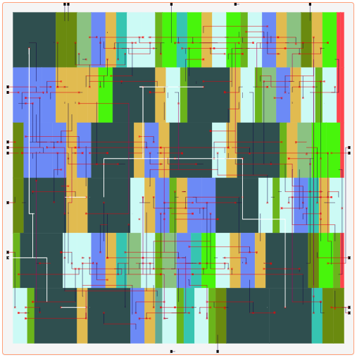
All Together

Slide 11
Libs/tools used
- svgZoomPan https://github.com/ariutta/svg-pan-zoom
- jquery, JavaScript, HTML, CSS
- DEF and LEF parser https://github.com/claude-abounegm/DEF-Viewer/tree/master/DEFViewer/Scripts/Custom
- Bootstrap

Slide 12
Design issues
- Some of the features might not be supported on older browsers.

Slide 13
How to build the solution
- just open the index.html file

Slide 14
LIVE DEMO
https://def2svg.000webhostapp.com/

Slide 15
Remaining work
- Adding DRC error checking for Vias
- Improving the UI colors
- Testing the compatibility on different browsers
- More testing!

Slide 16
Who did what?
- Ahmed Sharaf-Eldein
Programing interface for SVG drawing.
Exporting to SVG file format.
SVG layering.
- Alaa Mohamed
Finding DRC errors.
Graphically highlighting DRC errors in the layout.
Adding Feedback alerts
- Ahmed Marzouk
Drawing and scaling the layout.
Adding the hover effect.
Adding the search feature.
- Ahmed Fayed
Integrating all the new features together.
Testing Everything.
User interface design.

Slide 17
THANK YOU

